Slide 1

Chapter 23

Slide 2
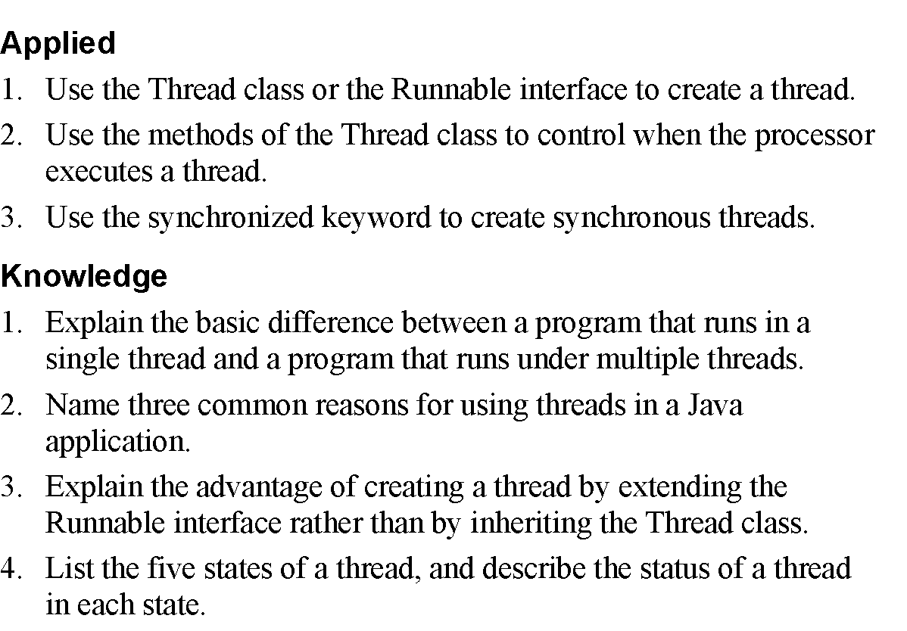
Objectives

Slide 3
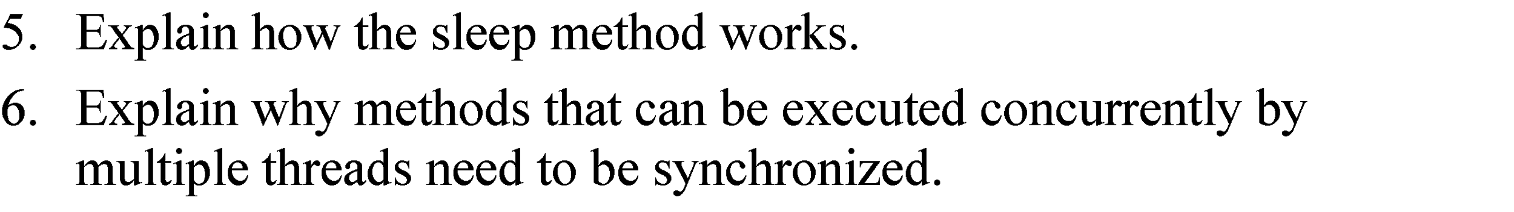
Objectives (cont.)

Slide 4
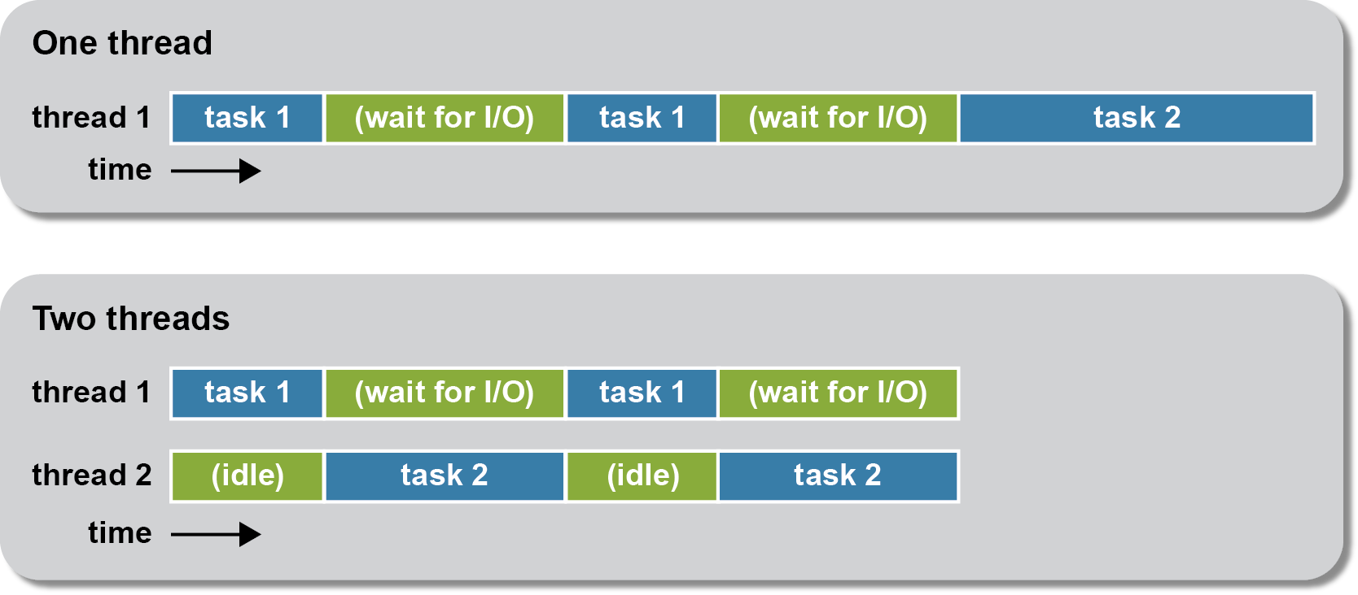
How using threads can improve performance

Slide 5
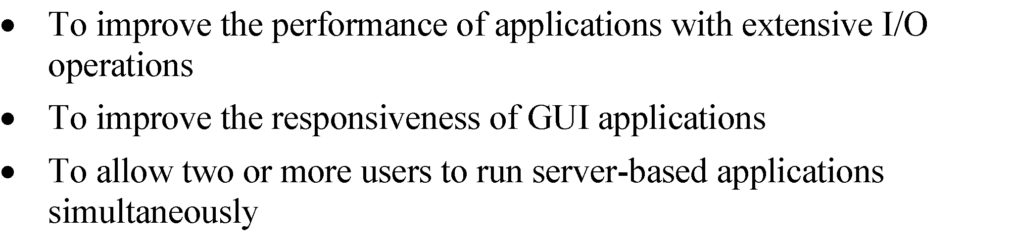
Typical uses for threads

Slide 6
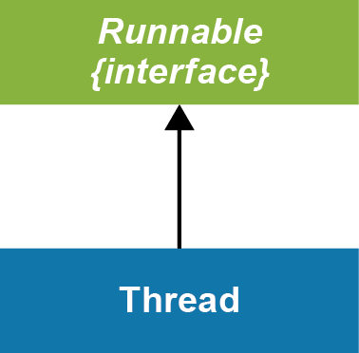
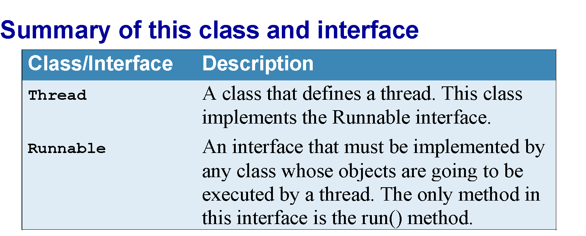
An interface and a class used to create threads

Slide 7
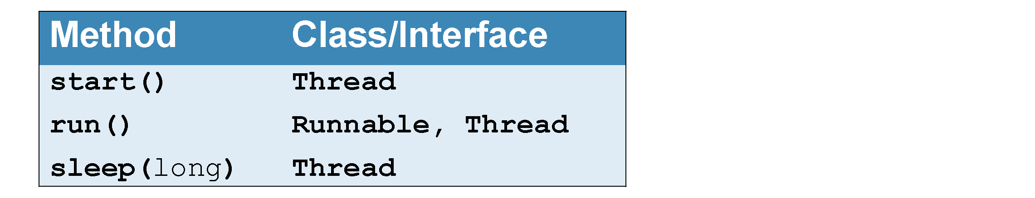
Key methods of the Thread class and Runnable interface

Slide 8
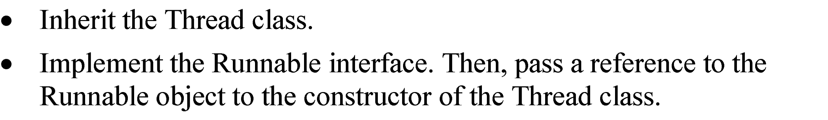
Two ways to create a thread

Slide 9
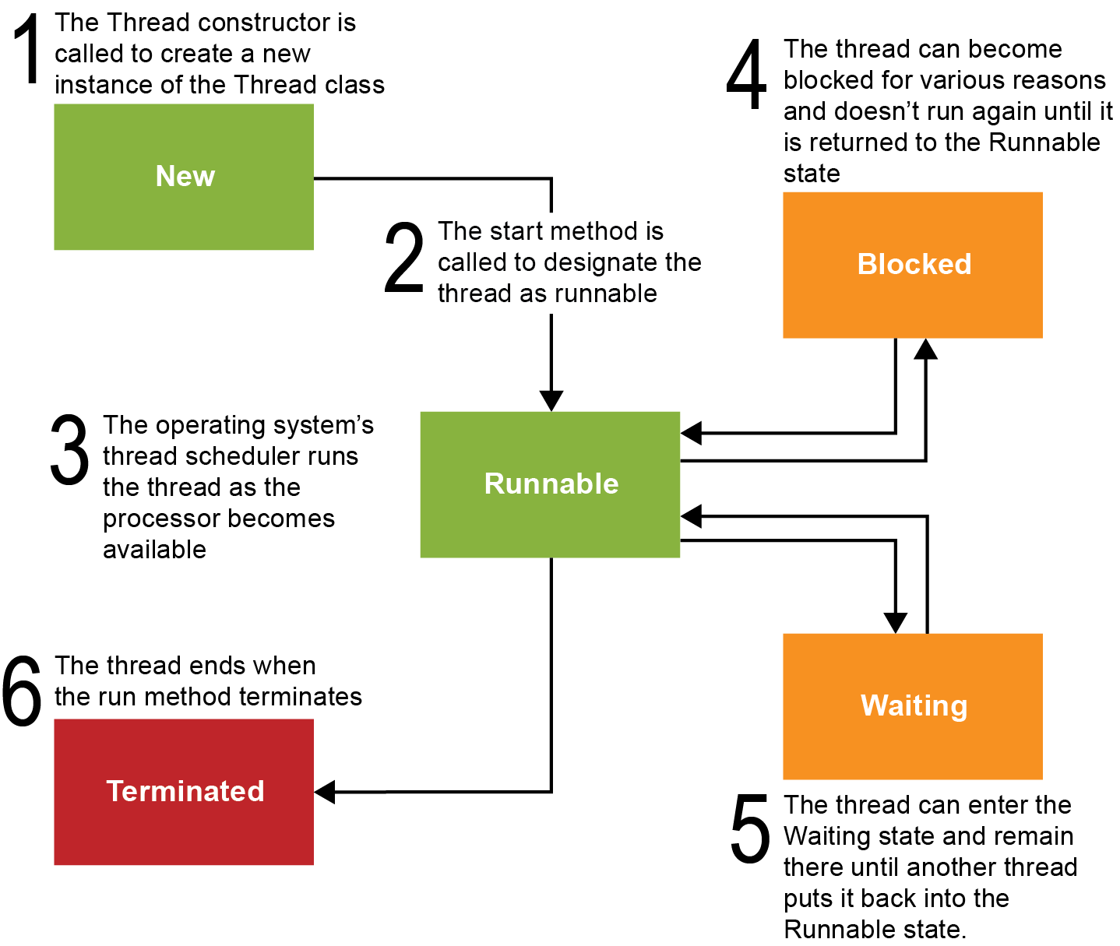
The life cycle of a thread

Slide 10

Thread states

Slide 11
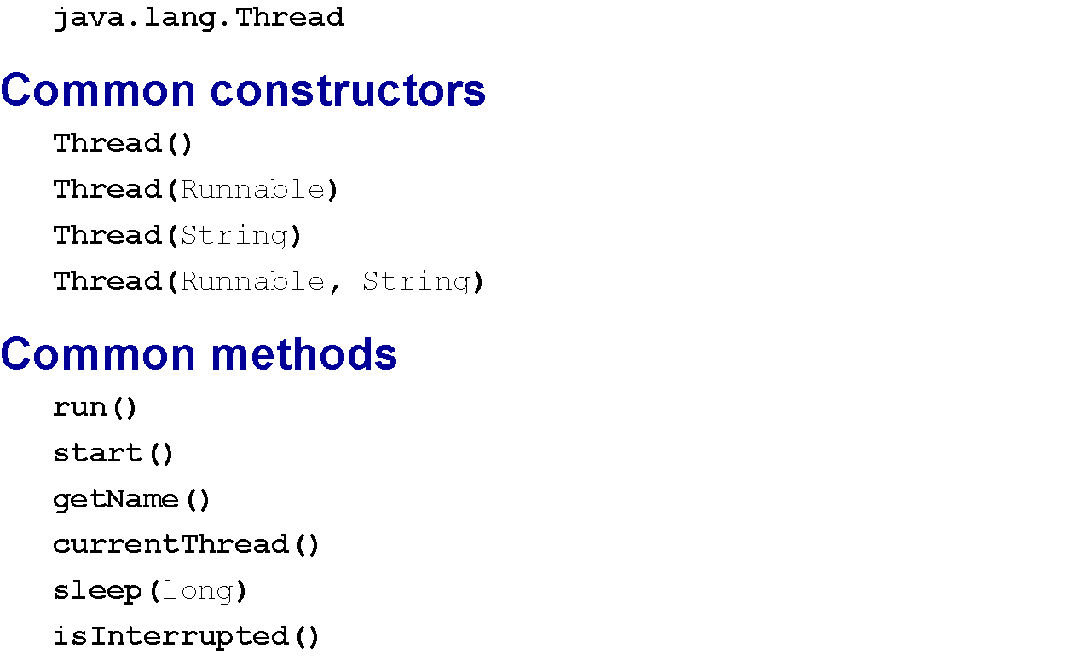
The Thread class

Slide 12
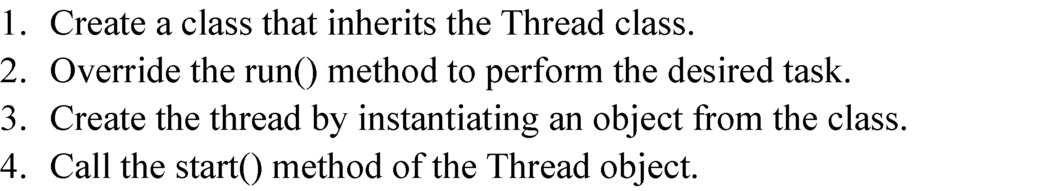
How to create a thread from the Thread class

Slide 13
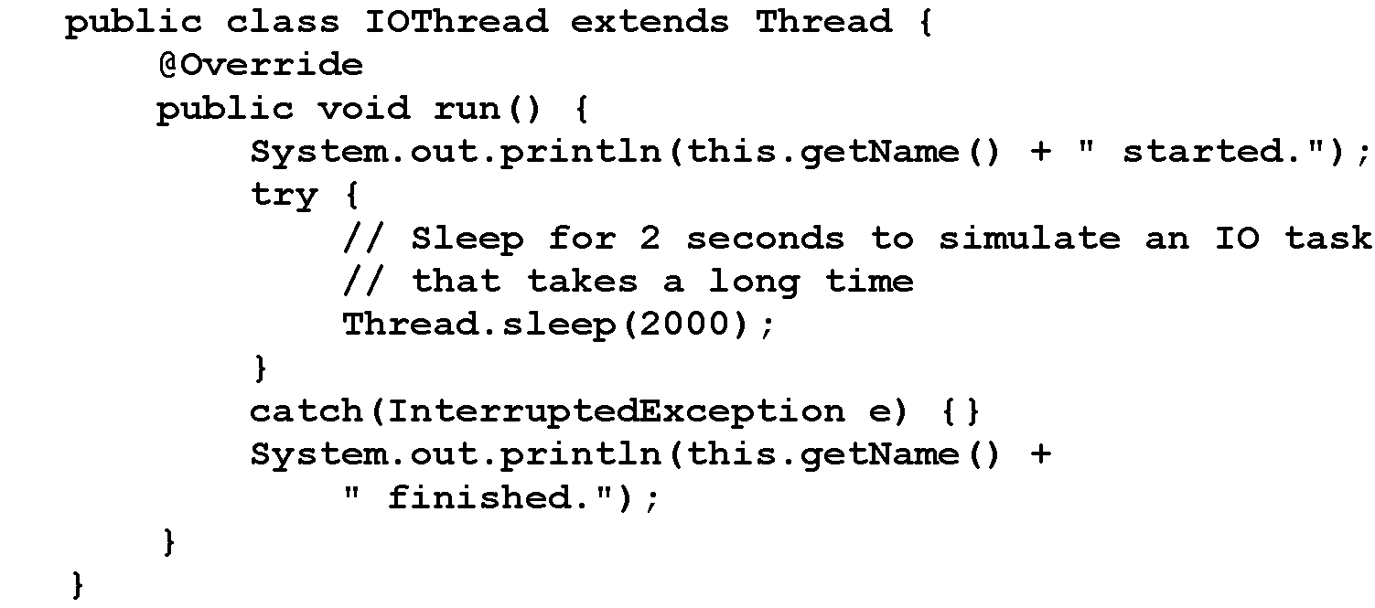
A class named IOThread that defines a thread

Slide 14
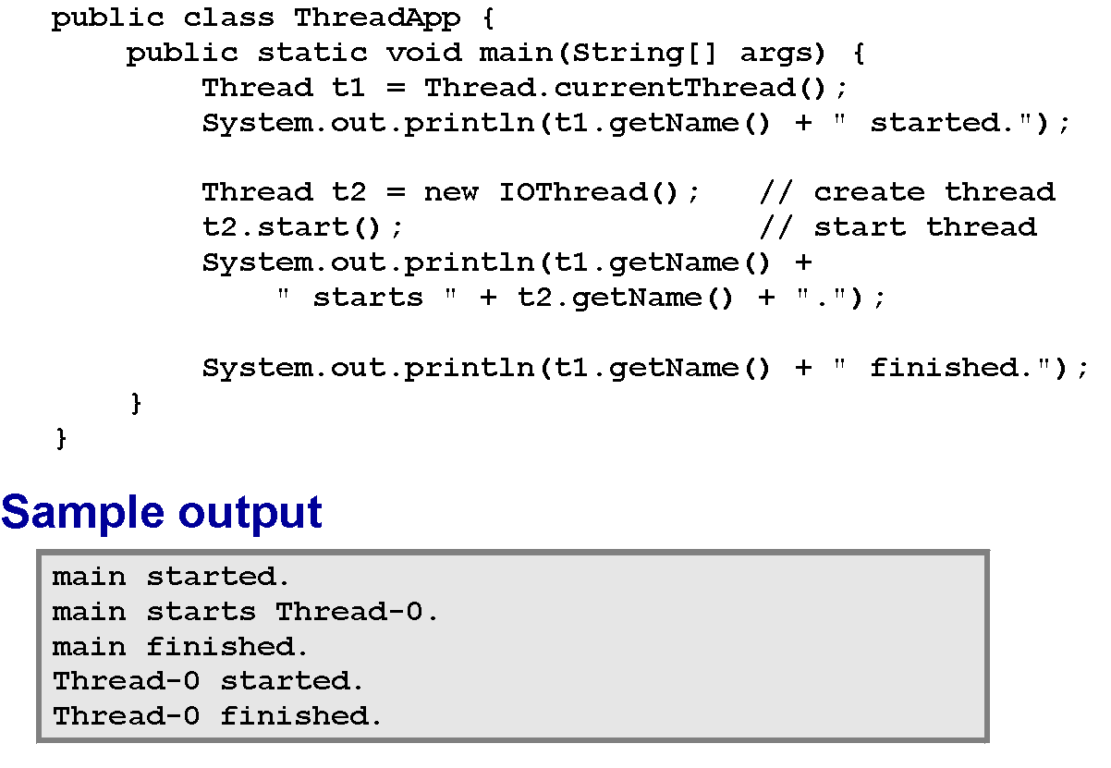
A ThreadApp class that starts a thread

Slide 15
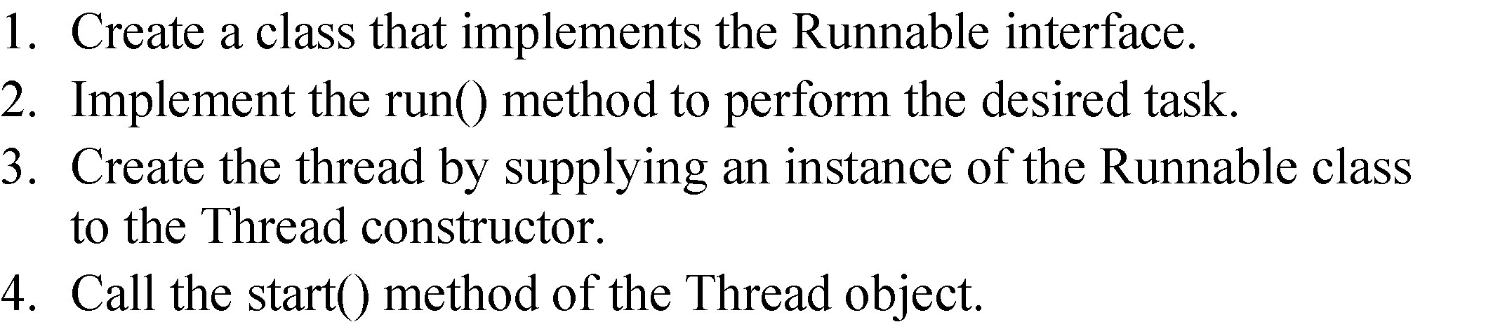
How to create a thread using the Runnable interface

Slide 16
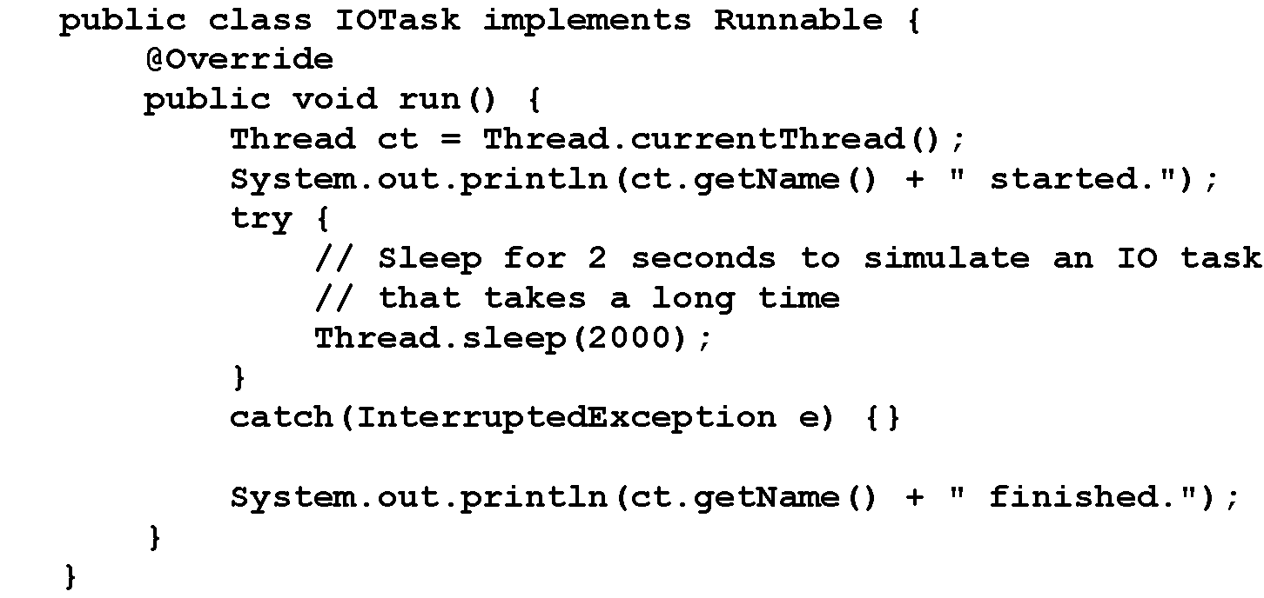
An IOTask class that implements the Runnable interface

Slide 17
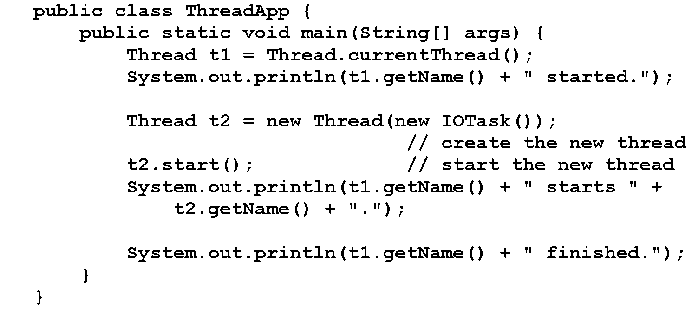
A ThreadApp class that starts a thread using the Runnable interface

Slide 18

Sample output using the Runnable interface

Slide 19

The syntax for creating a synchronized method

Slide 20
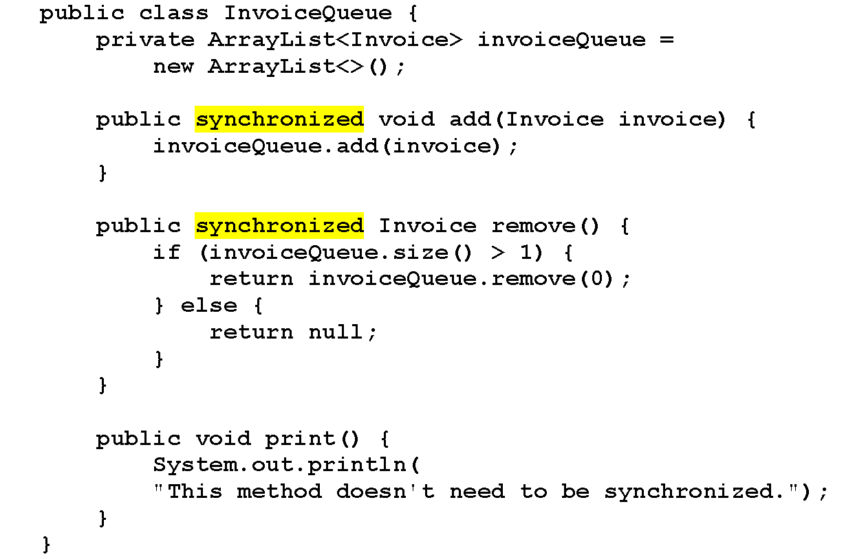
A class that contains two synchronized methods

Slide 21
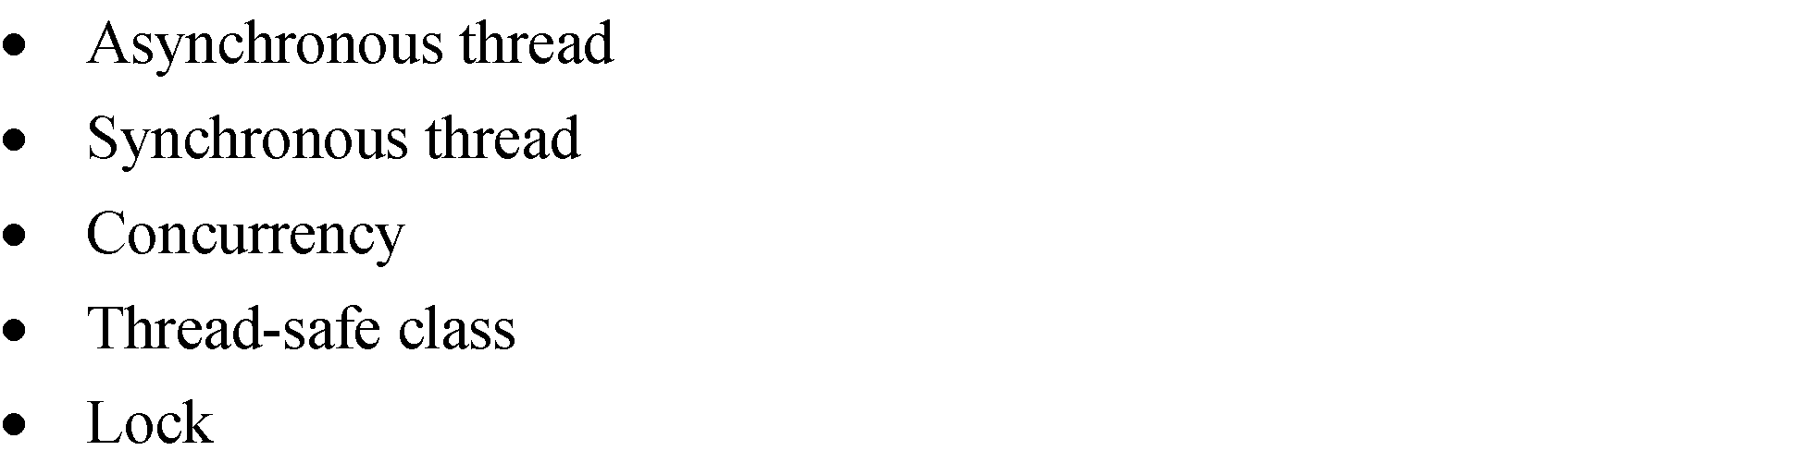
Terms

